Slide 1
Comparison of Ridge Regression With Random Forest Algorithm When Solving Boston Housing Problem
By: Fabio Eugenio dos Santos de Sampaio Doria

Slide 2
Introduction
Aims
Implement Ridge Regression Machine learning method.
Run and analyse performance on Boston Housing Problem Dataset.
Repeat same process for Random Forest algorithm and compare the results.
Objectives
Create program using Object-Oriented Design.
Full implementation life cycle.
Display data visualisation when using different parameters and Kernels.

Slide 3
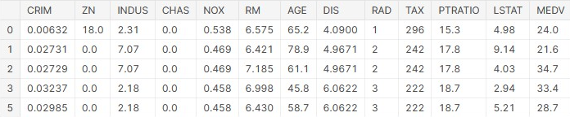
Context – Why the issue matters
Significance of Boston Housing Dataset
Individual Impact – Finding fair prices of houses for families
Large-scale Impact (Economy) – House prices linked to consumer spending
Significance of Comparing Algorithms
Performance – Can impact accuracy and speed of predictions
Generalisation – Under and over fitting issues can occur
Labels

Slide 4
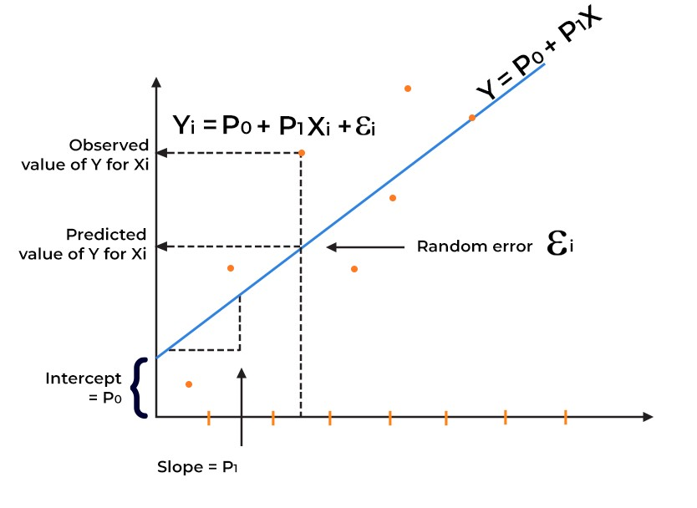
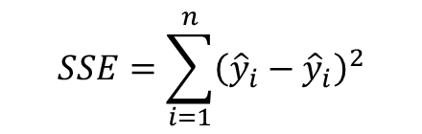
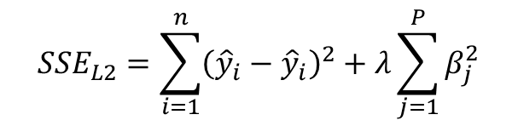
Main Concepts
Regression in Machine Learning
Supervised learning – Provide labels to new unlabelled samples
Learn from a set of labelled samples, i.e., houses z
Occurs when prediction set is infinite (house prices = Real Numbers)
Sum of squares error equation is used to find line of best fit through data
Ridge Regression
Improvement over regular regression algorithm, specifically overfitting
Adds a ‘penalty term’ to the end of SSE equation
Regularises the model by adding bias which decreases accuracy but improves overall performance
$$SSE=\sum_{i=1}^{n}{{\left({\hat{y}}_{i}−{\hat{y}}_{i}\right)}^{2}}$$
$${SSE}_{L2}=\sum_{i=1}^{n}{{\left({\hat{y}}_{i}−{\hat{y}}_{i}\right)}^{2}+λ\sum_{j=1}^{P}{β_{j}^{2}}}$$

Slide 5
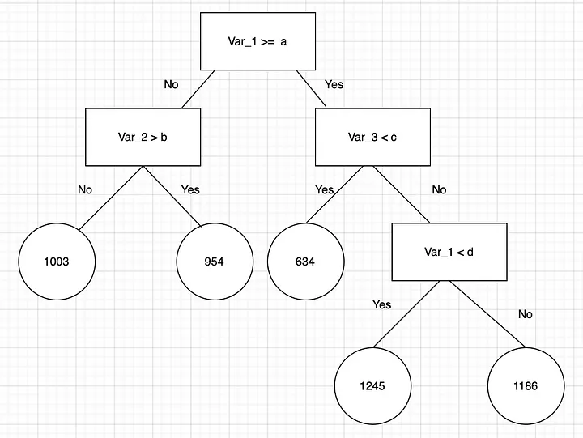
Main Concepts
Random Forest
Breaks dataset down into smaller subsets.
At the same time deploys decision trees.
Multiple models are trained, each using random subsets of the dataset.
Average result of all models are average to find predicted value.
Benefits
Resilient to overfitting due to large number of random subsets.
Multiple trees can be trained in parallel, computationally more efficient.
Easy to identify important features as they are
$$SSE=\sum_{i=1}^{n}{{\left({\hat{y}}_{i}−{\hat{y}}_{i}\right)}^{2}}$$
$${SSE}_{L2}=\sum_{i=1}^{n}{{\left({\hat{y}}_{i}−{\hat{y}}_{i}\right)}^{2}+λ\sum_{j=1}^{P}{β_{j}^{2}}}$$

Slide 6
My approach – Progress so far
Preparation
In-depth research on Ridge Regression and Random Forest algorithms
Gather information from both articles and research papers
Found datasets with different number of features for testing
Code
Completed Ridge Regression model implementation into program
Started implementation of Random Forest algorithm
Using Test Driven Development (TDD) to follow modern software engineering principles

Slide 7
Conclusion – Further Steps
Code
Fully implement Random Forest algorithm
Implement a proper graphical user interface (GUI)
Add automatic tests that examine comparison of different kernels and parameters
Write-up
Reflect and discuss findings, compare both results and come to a conclusion on both algorithms
Detail specific issues with implementation, such as data structures and numerical methods needed

Slide 8
Summary
Main Goal
Define the difference in performance between Ridge Regression and Random Forest algorithm.
How to get there
Create program implementing both algorithms and run them on Boston Housing problem Dataset
Do so in a proper manner, i.e., proper software principles followed, full OOP design, user graphical interface.
Program shows complete breakdown of results.
Data visualisation.
Shows results when using different parameters etc, for optimisation.

